Slide 1
GROUP 7
Understanding Mobile Application Architecture
Exploring Frameworks, Patterns and Best Practices for Efficient Mobile App Development

Slide 2
Outline
01
02
03
04
Types of Mobile Apps
Mobile Apps Programming Languages
Review, compare and difference
Review and comparison of mobile of Mobile App PLs
Mobile Apps Frameworks
Architecture and design patterns
Key features, language, performance, cost, UX, UI
Rules, processes and internal structure

Slide 3
Outline
05
06
User requirements for a mobile App
Mobile App Cost
Study of the collection and analysis
How to estimate the development cost

Slide 4
Introduction
A mobile App is a computer or software application designed to run on mobile devices.
They are designed to provide specific functions and services and they might not be able to provide the same level of functionality as a desktop application That is why understanding their structure is key

Slide 5
01
Types of Mobile Apps

Slide 6








Types of Mobile Apps
Native App
Hybrid App
Web App
Progressive Web App
Lite

Slide 7
Native App
These are mobile applications that are specifically designed and developed for a particular mobile platform, such as iOS or Android, and can be downloaded from the platform's app store.
Native apps are optimized for the platform they are built on and can access device features, such as GPS, camera, and contacts.
They typically offer the best performance and user experience.

Slide 8
Hybrid App
These are mobile applications that combine the features of native and web apps.
They are built using web technologies but are packaged as native apps and can be downloaded from app stores.
Hybrid apps can access device features and offer better performance than web apps, but may not be as optimized as native apps.

Slide 9
Hybrid App
These are mobile applications that are accessed through a mobile browser and are built using web technologies like HTML, CSS, and JavaScript.
Web apps are not installed on the device, and users can access them using a URL.
They can work across different platforms and do not require any installation, but may have limited functionality compared to native apps.

Slide 10
Progressive Web App
These are web applications that use modern web technologies to provide an app-like experience.E.g Twitter Lite
PWAs can be accessed through a mobile browser and can be installed on the user's home screen.
They offer features like push notifications, offline mode, and access to device features, making them a good compromise between web and native apps.

Slide 11
02
Mobile Apps Programming Languages

Slide 12
Here, will review popular mobile app programming languages in terms of performance characteristics, optimisations, advantages and disadvantages.
Java (Android)
Kotlin (Android)
Swift (iOS)

Slide 13

Java
It is known for its versatility, reliability and extensive ecosystem.
It is object-oriented which facilitates modular and reusable code.

Slide 14
Performance Characteristics
Footprint
The amount of memory and CPU resources consumed by a Java application
Throughput
The amount of work that can be performed by a Java application within a given period of time.
Latency
The time it takes for a Java application to respond to user requests

Slide 15
Performance Optimisations
Optimize Memory Usage
Use StringBuilder for string Concatenation
Use Caching and Memoization

Slide 16
Advantages and Disadvantages of Java
Straightforward
Object-oriented
Memory distribution
Multithreaded
Slower language
Default GUI (Swinng) is not so good
Requires a lot of memory space
Codes are verbose

Slide 17
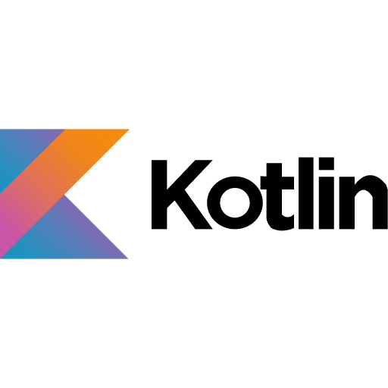
Kotlin
Released in 2016 by JetBrains
It is compatible with Java.
Modern, statically typed language becoming the standard for Android development.

Slide 18
Performance Characteristics
Null-safety
It prevents null pointer exceptions, which is advantageous for reliability
Use of inline functions and lambda
Inline functions are a powerful tool that can reduce overhead

Slide 19
Performance Optimisation
Use “val” instead or “var” where possible
Leverage the power of inline functions
Smart casting over Manual casting

Slide 20
Advantages and Disadvantages of Kotlin
Smaller learning curve
Productivity improvement
Fewer bugs
Incorporate with Java
Not as mature as Java
A bit slower
Hiring can be difficult

Slide 21
Performance Characteristics
Quick start-up time
Swift-based apps start quickly since there is almost no warm-up operations
Expressive and safe
Enforces type-safety, optionals and memory-safety features
Supported ecosystem
Contains many useful libraries and tools

Slide 22
Performance Optimisation
Set optimisation level in build settings
To optimise your code, let XCode do that itself
Use “Final” and “Private”
“Inline” your code
It’s always best practice to create small functions, with each function dedicated to a single task.

Slide 23
Advantages and Disadvantages of Swift
Easy to learn and understand
Powerful programming language for building better apps
Trust and Security
Long term development support and great community
Not really popular
Poor interoperability with third-party tools and IDEs
Lacks support for previous iOS versions

Slide 24
03
Mobile Apps Frameworks

Slide 25
Here, we review and compare popular mobile app development framework based on key features:
Language
Performance
Cost & Time to Market
UX & UI
Complexity
Community Support

Slide 26


Popular Mobile App Dev Frameworks
Native
Hybrid
Web App
An application specifically designed for a particular platform or device
A combination of both native & web applications. It can be developed for any platform from a single
An application that is designed to deliiver web pages on different web platforms for any device
React Native
Flutter
Xamarin
Apache Cordova(Adobe)
Ionic( Angular)
Swift(iOS)
Kotlin(Android)

Slide 27
Native Development Frameworks
Framework | Performance | Cost & Time To Market | UX & UI | Complexity/ Language | Community Support
Swift(Native - iOS) | Excellent(Optimized for Apple hardware) | Higher (Potentially) | Full access to native UI components & design patterns | Moderate(Learn Swift) | Large & active community, extensive Apple documentation
Kotlin(Native - adroid) | Excellent(Optimized for Android) | Higher (Potentially) | Full access to native UI components & design patterns | Moderate(Learn Kotlin) | Large & active community, extensive Apple documentation

Slide 28
Hybrid Development Frameworks
Framework | Performance | Cost & Time To Market | UX & UI | Complexity/ Language | Community Support
React Native (Hybrid) | Good(may have limitations) | Moderate(faster with single codebase) | Near-native look & feel with good libraries | Moderate(learn Javascript and React) | Large & active community, extensive
Flutter (Hybrid) | Very Good(custom rendering engine) | Moderate(faster with single codebase) | Excellent UI capabilities with rich widgets | Moderate(Learn Dart) | Growing community, good resources
Xamarin( Hybrid) | Good(may have limitations) | Moderate( faster with single codebase) | Good UI with integration of native controls | Moderate (learn C#) | Large .NET developer community

Slide 29
Web-Based Development Frameworks
Framework | Performance | Cost & Time To Market | UX & UI | Complexity/ Language | Community Support
Apache Cordava( web-based) | Lower(limited native features) | Lower(faster with web skills) | More limited UI capabilities | Lower(familiar web technologies like HTML,CSS, Javascript ) | Moderate community, Adobe documentation
Ionic(Web-based) | Lower(limited native features) | Lower(faster with web skills) | More limited UI capabilities | Lower(familiar web technologies, might involve additional frameworks like HTML,CSS, Javascript with frameworks) | Moderate community, Angular community support

Slide 30


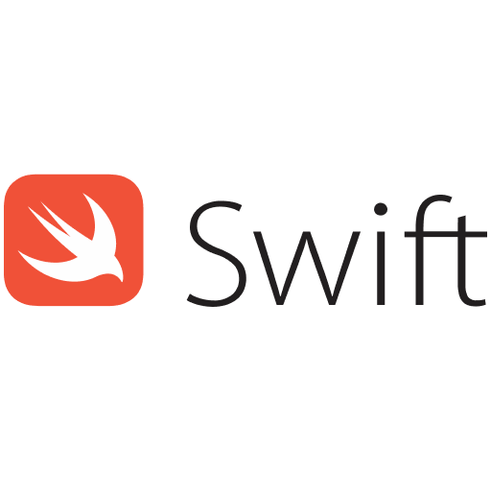


Where to use
Android
Hybrid (iOS, Android)
Hybrid (iOS, Android)
iOS
Hybrid (iOS, Android, Web)
Hybrid (iOS, Android, Web)
Hybrid (iOS, Android, Windows)

Slide 31
04
Architecture and Design Pattern

Slide 32
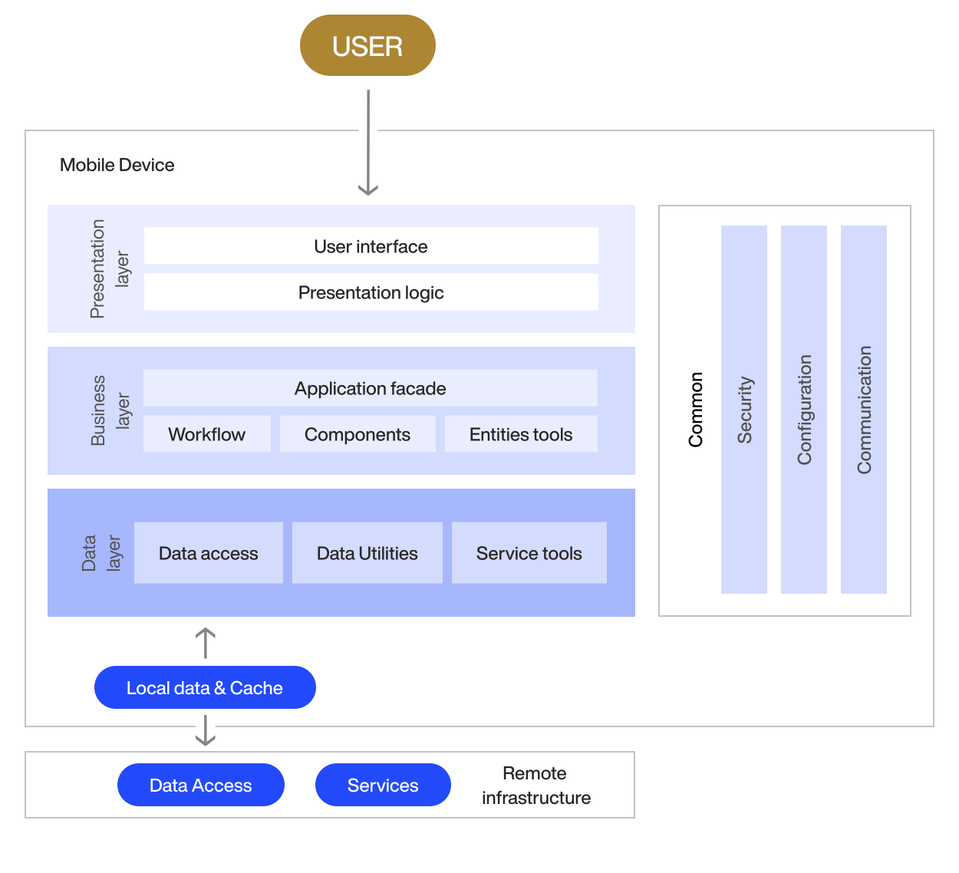
In app development, architecture refers to an
app’s rules, processes, and internal structure—
essentially, how it’s built.
It determines how the different
components communicate with each
other to process app inputs and deliver
output for the user.
A good analogy is the human body. Any changes in the structure of your organs
would affect the body irreversibly.
The same is true with mobile app architecture

Slide 33
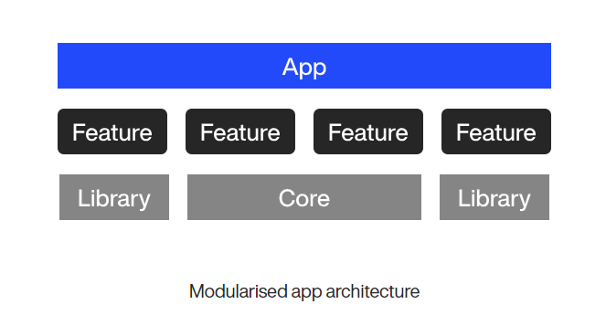
Why is the Architecture of a Mobile App important
Stability and Efficiency
Modularity
mobile app operates smoothly and efficiently, minimizing crashes and slowdowns
Divides the app into independent components, making it easier to develop, update, and test new features without impacting the entire app
Cost and Time Savings
Simplifies the process of adding new capabilities to the app, reducing development costs and
time-to-market.
Enhanced Security
Fosters reusability
Compartmentalization of sensitive code improves security.
Implementation of security protocols, such as encryption layers, to protect data integrity and user privacy

Slide 34
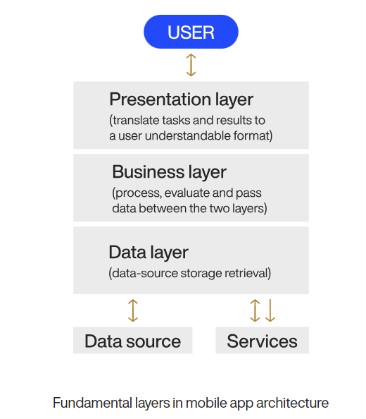
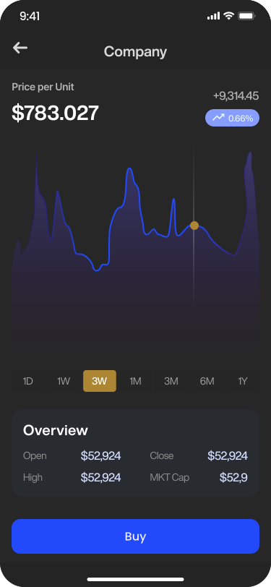
Mobile App Layers
Business Layer
Data Layer
- Contains core application logic and instructions for behavior. - Processes data received from the data layer. - Can be divided into sublayers or components for specific functionalities. Example: Performs calculations in a calculator app.
- Intermediary between app layers and external resources. - Gathers raw data from sources like databases, cloud servers, or APIs. - Ensures proper segregation of data and handles security measures. - Example: Retrieves user profile data from the database for display.
Presentation Layer
- Visible part of the app, including the user interface (UI). - Displays data received from the business layer in a user-friendly manner. – Utilizes UI and UX design principles for optimal user experience. - Example: Displays live stock market data in a graph or chart format in a trading app.

Slide 35
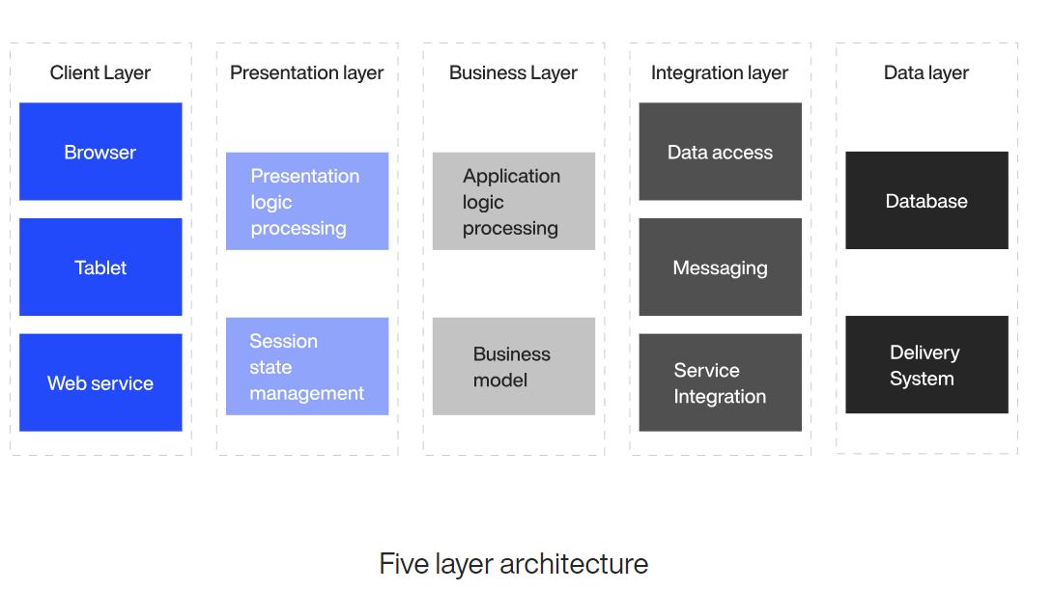
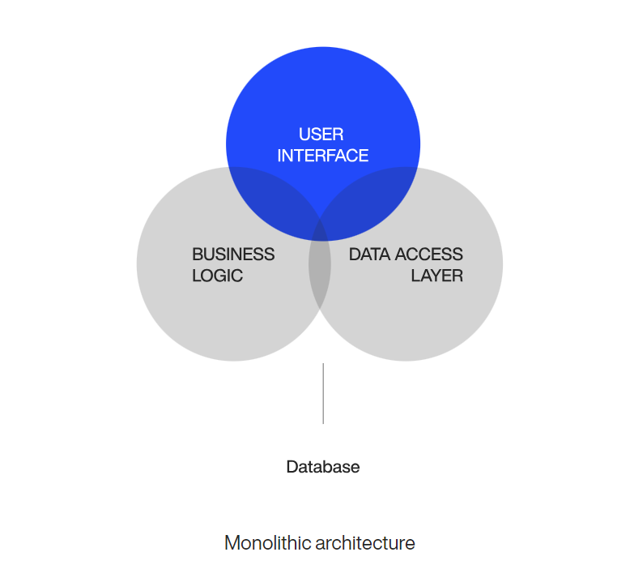
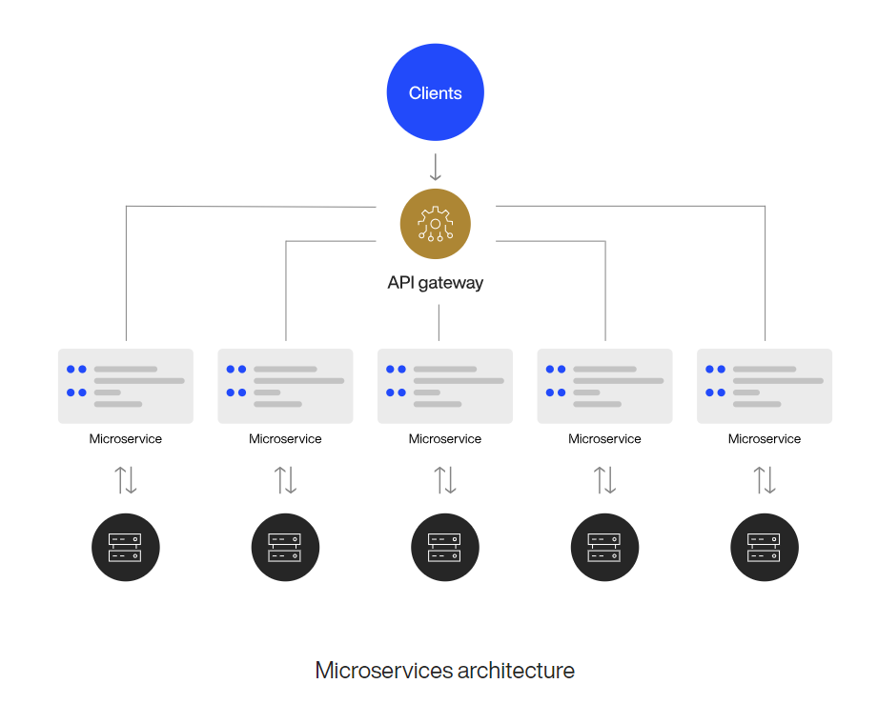
Macro Architecture
of Mobile App
Layered
- Components organized based on their logic purpose.
- May comprise of additional layers to accommodate intricacies out of the 3 main layer
- Layers can only pass data to and from an adjacent layer. as it helps manage dependencies and enforce security.
Monolithic
- Consolidates all app components into a cohesive unit referred to as a monolith.
- Suitable for smaller applications for its simplicity
- Complex modification of code base in case of feature changes, making it complex to scale and update
Microservices
- Decomposes the application into smaller standalone and independently-operable components known as microservices, - Communicate with the main client app through APIs. enables rapid scaling, of apps
- suitable for developing complex
cloud and hybrid applications

Slide 36
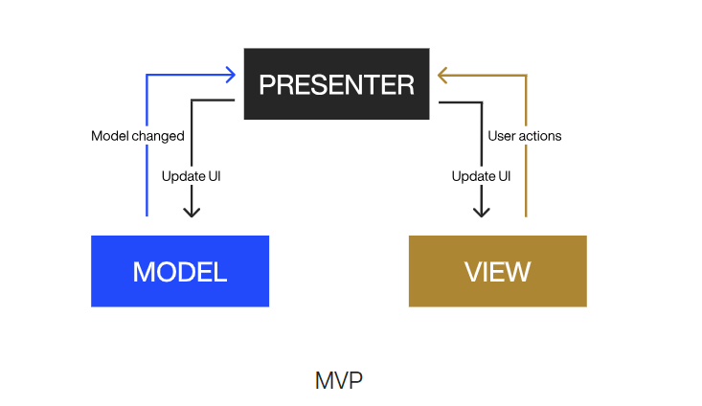


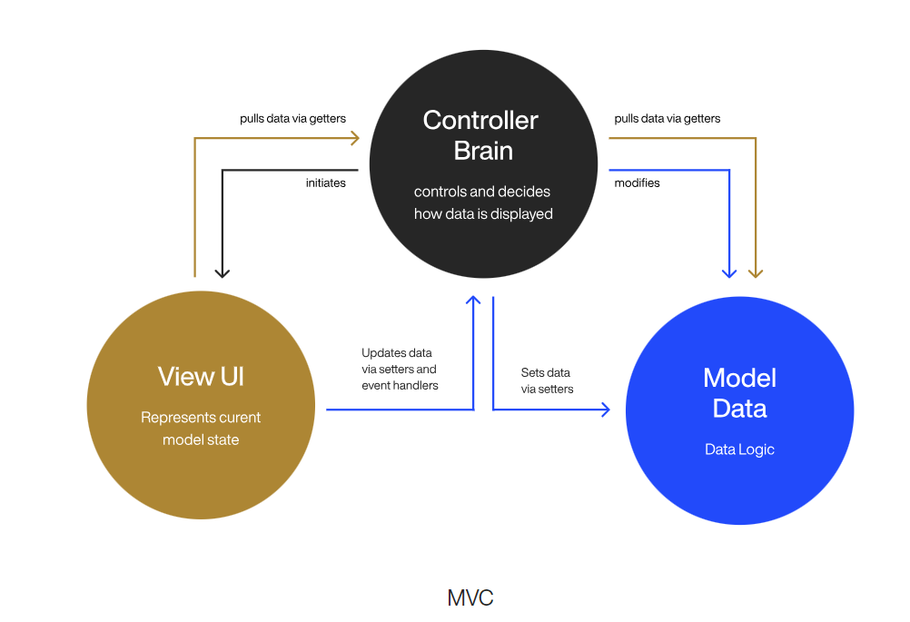
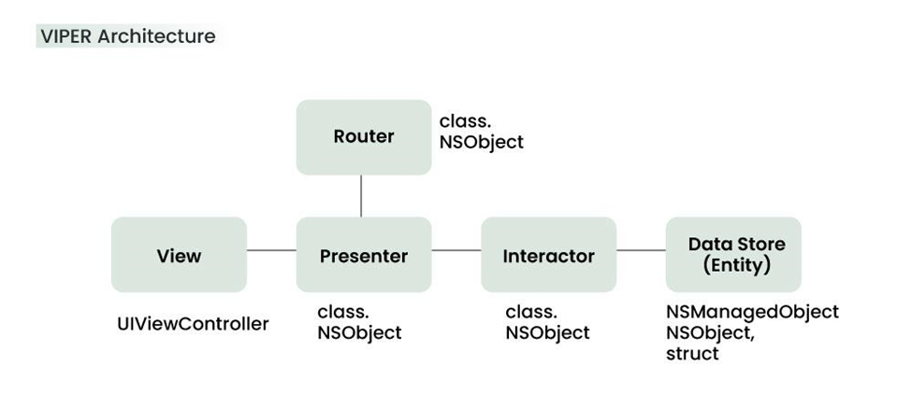
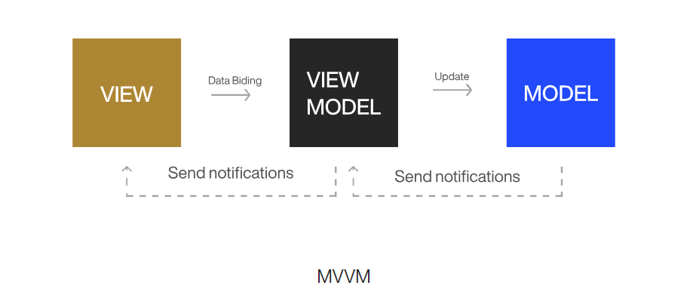
Mobile App Architecture Patterns

Slide 37
Mobile App Design Patterns
1
2
3
Singleton Method
Factory Method
Observer Method
Ensures there is only one instance of a class and provides global access
Defines an interface for creating objects, allowing subclasses to modify the type of the created object
Establishes one-to-many dependencies between objects, notifying dependents, of state changes
4
5
6
Dependency Injection
Adapter Method
Strategy Method
Provides class dependencies externally rather than creating them within the class
Allows using interface of an existing class as a link to a new one
Defines a family of algorithm, providing flexibility to select the appropriate at run time

Slide 38



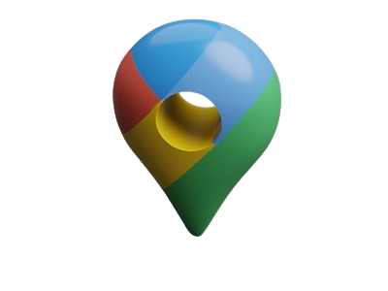
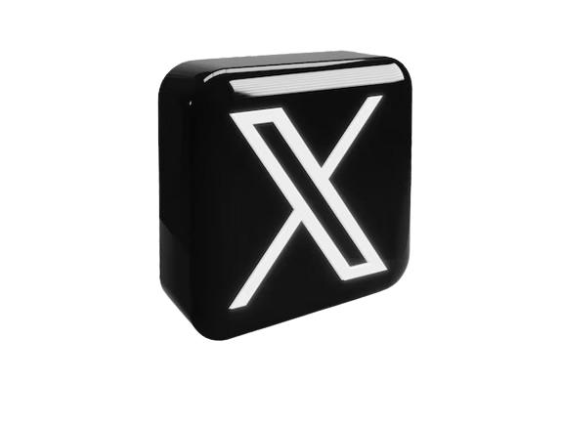
Case Studies
Architecture: MVP and MVVM Design Pattern: Observer, to handle user interaction and UI updates
Case Study: Observer pattern enables
real-time updates of the UI for
a seamless experience
Architecture: Micro services
Design Pattern: Factory pattern to create various types of rides and services
Case Study: Factory pattern helps to dynamically create different rides based on user request and preferences
Architecture: MVP
Design Pattern: Strategy pattern to implement different routing algorithms and map display
Case Study: Strategy pattern allows Google Map to switch between different routing algorithm, providing users with optimized navigation routes
Architecture: VIPER
Design Pattern: Dependency Injection
Case Study: DI simplifies management of dependencies and facilitates unit testing of individual components, enhancing quality
Architecture: micro services (backend),
MVVM (mobile apps)
Design Pattern: Observer Pattern
Case Study: Observer pattern enables Netflix to deliver personalized content recommendation to users based on their view history or preferences

Slide 39
05
User Requirements for a Mobile App
Collection
&
Analysis

Slide 40
-> User requirements refer to the needs expectations and preferences of the people (users) that will use a system.
-> They essential for designing and developing a system that meets the goals and solves the problem of the users.

Slide 41
36%
64%
“Early mistakes lead to costly fixes” - Anonymous
From Origin of Software Defects (Source: Crosstalk, the Journal of Defense Software Engineering)
Coding/Implementation Phase
Requirement Analysis and Design Phase

Slide 42
User Requirement Collection Methods
Surveys and Questionnaires
User Analytics
1
4
To gather quantitative data on user preferences.
Utilize analytics tools within existing apps to gather data on user interactions.
Interviews
2
Conduct one-on-one or interviews group interviews to gather qualitative analysis
Feedback via prototypes
5
Provide channels for users to submit feedback, feature requests, and bug reports
Observation
Observe app users as they interact with similar mobile apps.
3

Slide 43
Analysis of User Requirement Data Collected
Analyze survey responses to identify common trends, preferences, and pain points
Analyze quantitative data to identify patterns, trends, and areas for improvement.
1
4
Transcribe and analyze interview recordings or notes to identify recurring themes, motivations, and specific requirements.
Monitor and analyze user feedback regularly to identify common issues, feature requests, and areas for improvement.
2
5
Document user behaviors, pain points, and workflow inefficiencies.
3

Slide 44



3 free platforms for user requirement data collection and analysis
Google Forms
Survey Monkey
JotForm

Slide 45
06
Mobile App Cost

Slide 46

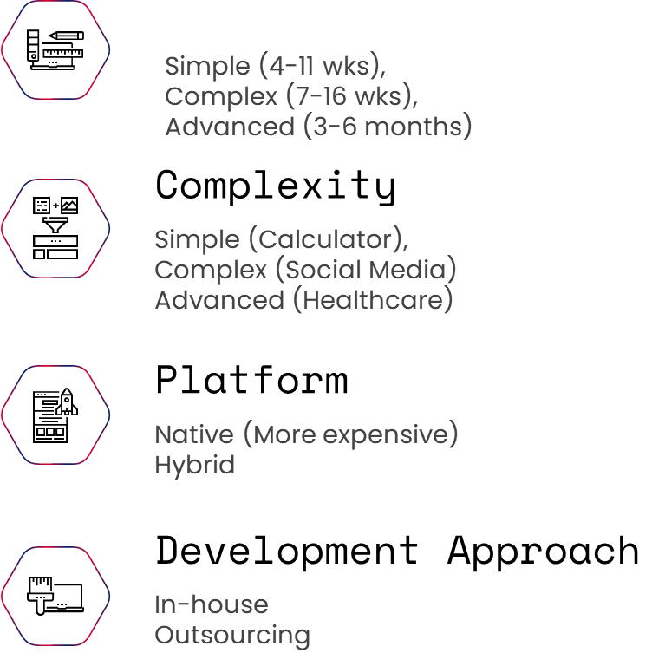

Slide 47
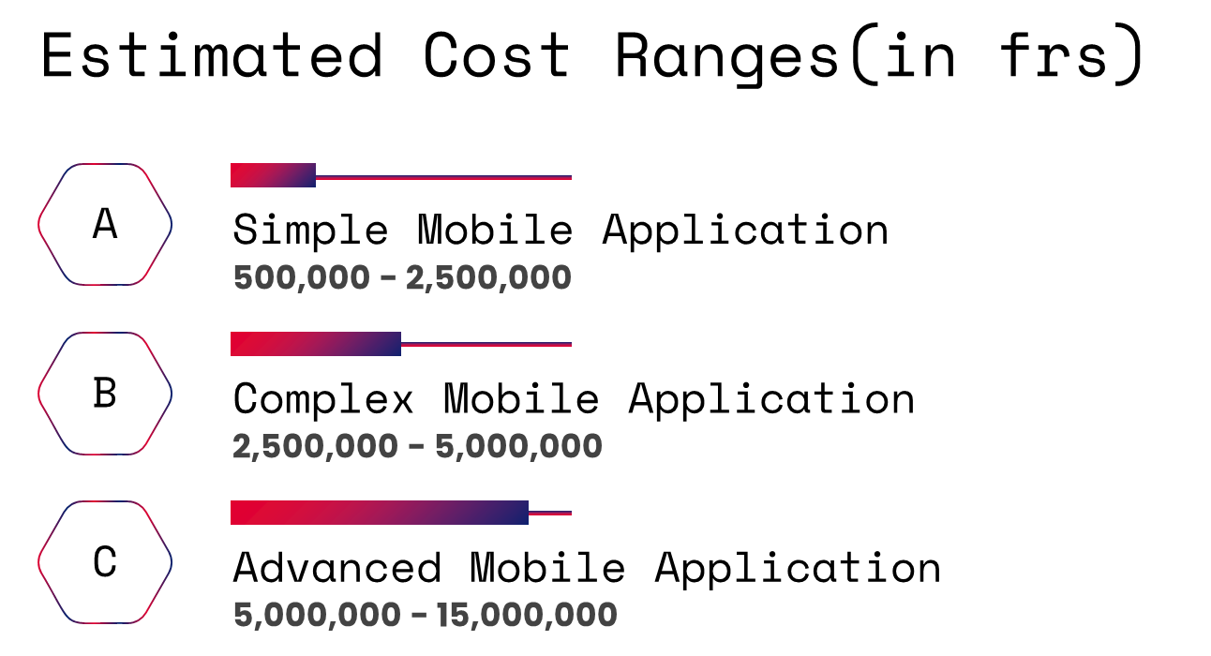

Slide 48
Conclusion

Slide 49
Thank you!
Do you have any questions?

